Slide 1
Introduction to Systems Thinking
Systems Thinking: Seeing the Forest, Not Just the Trees : Solving Complex Problems in the Nigerian AI Landscape
Learning Objectives
By the end of this session, you will:
Contextualize: Identify how AI can transform Nigerian economy from Fintech, Health, Agriculture, among others.

Slide 2
Why Systems Thinking for AI?
Definition: A holistic approach to analysis that focuses on how a system's constituent parts interrelate and how systems work over time.
In Data Science, we often focus on a single metric (like Accuracy). Systems thinking asks:
Interconnection: How does this model affect the people using it?
Context: Is the data a true reflection of the environment?
Longevity: Will this solution cause a new problem tomorrow?
Linear vs. Systems:
Linear: A → B (Problem → Solution).
Systems: A affects B, B affects C, and C loops back to affect A.
Goal: Move from Linear Thinking (A causes B) to Circular Thinking (A affects B, which affects A) i.e, To solve the root cause of a problem, not just the symptoms.

Slide 3
Understanding Complex Problems as Interconnected Systems
A "System" is a group of interacting parts forming a complex whole.
Interconnectedness: In a system, everything is linked. You cannot change one part without affecting others.
The Component: A farmer in Kaduna.
The System: The Nigerian Agricultural Supply Chain (Weather, Transport, Markets, Middlemen).
The AI Role: If we build a price-prediction app, it doesn't just "predict"; it changes how the middlemen and farmers behave.
Example (Agriculture): A shortage of fertilizer isn't just a farming issue; it's a transport issue, a foreign exchange issue, and eventually, a food security/healthcare issue.
Notes:
Two models with the same accuracy behave very differently in deployment. Why? Distribution shift and variance: Because accuracy is an average, while deployment exposes models to changing data distributions and different levels of variance.

Slide 4
Stakeholders & Feedback Loops – The Heart of Systems
Stakeholders: Any individual, group, or organization that can affect or be affected by a system’s outcome.
Systems aren't static; they respond to change through loops.
Reinforcing Loops (Positive Feedback): "The rich get richer." In AI, this is a bias loop. If a model approves loans only for one group, it gets more data from that group, reinforcing the preference.
Balancing Loops (Negative Feedback): "The thermostat." These loops seek stability. For example, as food prices rise, demand drops, eventually stabilizing the price.

Slide 5
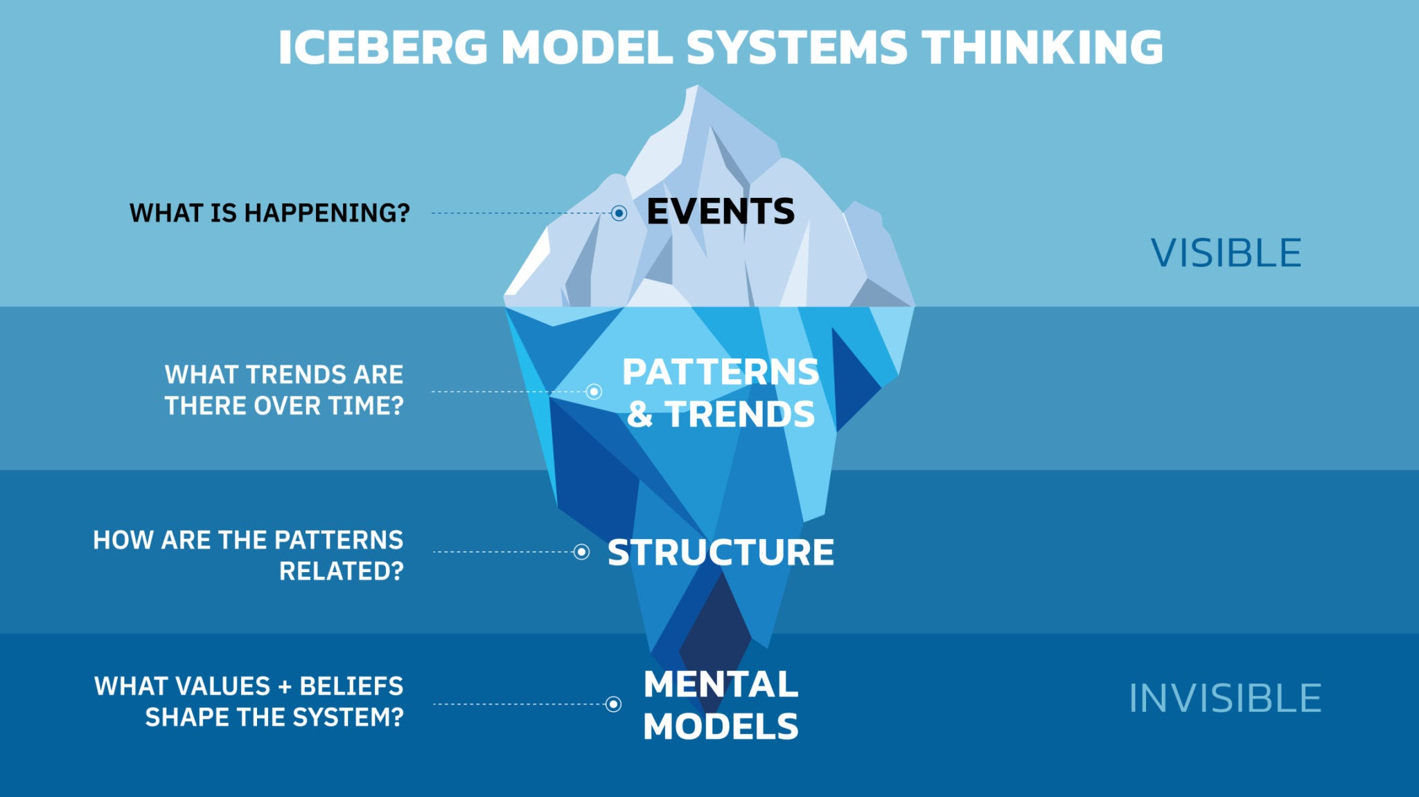
The Iceberg Model
We often only see the "Events" (the tip of the iceberg), but Systems Thinking looks deeper.
The Event: A healthcare app has low user retention in rural areas. What happened?
The Pattern: Users only log in when they are already critically ill. What has been happening over time?
The Structure: Lack of consistent internet or trust in digital diagnoses. How are the parts organized to cause this?
The Mental Model: "Medicine is only for when I can't walk." What do people believe?
Notes:
Unintended Consequences
Definition: Outcomes that are not intended by a purposeful action.
The Challenge: AI solutions often have "side effects."
Example: Automating credit scores in Fintech might unintentionally exclude people without smartphones, worsening financial inequality.
Question to Ask: "If we 'fix' this, what happens to the rest of the system?"

Slide 6
Unintended Consequences
Definition: Outcomes that are not intended by a purposeful action.
The Challenge: AI solutions often have "side effects."
Example: Automating credit scores in Fintech might unintentionally exclude people without smartphones, worsening financial inequality.
Question to Ask: "If we 'fix' this, what happens to the rest of the system?"
Notes:
Unintended Consequences
Definition: Outcomes that are not intended by a purposeful action.
The Challenge: AI solutions often have "side effects."
Example: Automating credit scores in Fintech might unintentionally exclude people without smartphones, worsening financial inequality.
Question to Ask: "If we 'fix' this, what happens to the rest of the system?"

Slide 7
Introduction to Stakeholder Mapping
Purpose: To identify who matters and how to manage their expectations. So before writing a single line of Python, you must know who is in the "room."
The Power/Interest Matrix (Grid):
High Power, High Interest: Manage Closely (Key players e.g., Government, Major Banks).
High Power, Low Interest: Meet their needs i.e., Keep Satisfied (Regulators/Investors).
Low Power, High Interest: Keep informed (The end-users/farmers/Community).
Low Power, Low Interest: Monitor only (General public).

Slide 8
Activity – Brainstorming Nigerian Market Problems
Task: Choose one sector (Agriculture, Healthcare, or Education) and analyse a common problem using systems thinking.
Step 1: Define the core problem.
Step 2: List at least 3 interconnected parts (e.g., Logistics, Government Policy, Trust).
Step 3: Identify major Stakeholders and potential Unintended Consequence.
Duration: 15 Minutes.

Slide 9
The System Mapping Template
Problem Landscape Worksheet
Sector: [Agriculture / Healthcare / Education]
Core Problem: ____________________________________________________
1. The Stakeholder Map
Who has the most to lose or is most affected by the change? (Low Power/High Interest): ______________
Who decides if the solution is allowed or legal? (High Power/Low Interest): ________
Who is your essential partner and critical to project success? (High Power / High Interest): ________
Who is minimally impacted and requires only general monitoring? (Low Power / Low Interest): ________
2. The Iceberg Analysis
The Event (Visible): What is the obvious problem? _____________________
The Pattern (History): How often does this happen? Is it getting worse? ___________________
The Structure (Systemic): What laws, physical setups, or policies keep this happening? (e.g., "Bad roads prevent transport," "High cost of mobile data," or "No existing database for patient records"): ___________________
The Mental Model (Beliefs): What do people believe that keeps this problem alive? (e.g., "AI is here to steal my job" or "Manual processes are safer than digital ones"): ___________________
3. The AI Intervention & Risk
Proposed AI Solution: _____________________________________________
The "Oops" Factor: What is one unintended consequence this AI might cause? (e.g., "The app works, but now nobody talks to the local doctors anymore"): ___________________________________________________________

Slide 10
Summary
Holistic View: Data isn't just numbers; it's a snapshot of a living system. Complex problems require looking at the whole, not just the parts.
Stakeholders: If you don't account for the user, the model will fail. Always map your stakeholders before designing an AI model.
Feedback: Always ask: "If I 'solve' this, what happens next?" Watch out for feedback loops that could make the problem worse.
Discussion Question: "Can you think of a time a 'solution' in Nigeria actually made a problem worse because of a lack of systems thinking?"

